Slide 1
Zipf’s Law in Action: Analyzing Global Sentiment Posts
TEAM:
Bhavya Jain
Harshit Jain
Vansh Dagar
Manish Balayan

Slide 2
Understanding Zipf’s Law
Zipf’s Law is an empirical law that states:
Relationship where the frequency of a word in a language corpus is inversely proportional to its rank in a frequency-sorted list.
Mathematical Expression:
f(r)∝1/r or f(r) = C/r
where:
f(r) = frequency of the word with rank rrr
r = rank of the word when sorted by frequency
C is constant

Slide 3
Interpretation:
The most common word occurs about twice as often as the second most common, three times as often as the third, and so on.
A few words are used very frequently, while most are used rarely.
Visual Pattern:
When plotting word frequency vs. rank on a log-log scale, Zipf's Law predicts a linear relationship with a negative slope.
Significance:
Observed across languages, books, tweets, and even datasets unrelated to language (e.g., city sizes, internet traffic).
Demonstrates how human language naturally organizes itself for efficiency and redundancy.

Slide 4
About the Dataset:
Dataset Name: sentimentdataset.csv
Source: Provided via Google Drive for the Maths + AI Project
Content Overview:
Contains 732 rows of real-world text data
Each row represents a user-generated sentence or post (similar to tweets or social media text)
These texts express a wide range of human sentiments and opinions
Primary Focus Column:
Text – This column includes the actual written content analyzed for word frequency
Why This Dataset?
It reflects natural language use across different contexts
Offers a rich source for studying linguistic patterns like Zipf’s Law
Diverse and globally relevant, making it ideal for testing statistical language theories

Slide 5
Tools and Techinques used:
Google Colab – Cloud-based environment for running the iPython notebook
Libraries Used:
pandas – For loading and handling the dataset
re – For regular expressions in text cleaning
collections.Counter – For counting word frequencies
matplotlib & numpy – For plotting and numerical computations
Text Preprocessing:
Converted text to lowercase, removed punctuation, special characters, and extra whitespace
Tokenized the sentences into individual words
Word Frequency Analysis:
Counted occurrences of each word and ranked words by frequency
Zipf's Law Validation:
Plotted word frequency vs. rank
Transformed data to a log-log scale and fitted a regression line to observe the Zipfian pattern

Slide 6
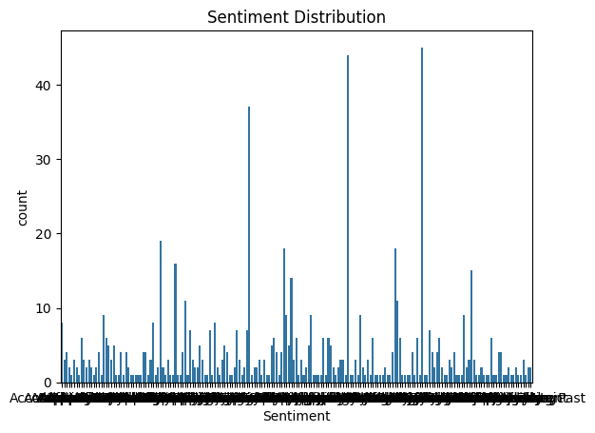
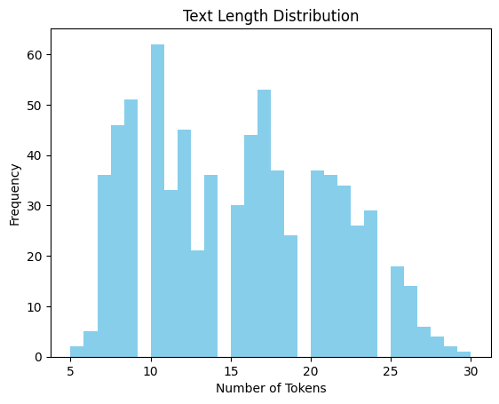
Data Processing:
Text Cleaning
Converted all text to lowercase to ensure uniformity
Removed:
Punctuation (e.g., commas, periods)
Special characters (e.g., emojis, hashtags)
Extra whitespace
Used regular expressions (re library) for efficient cleaning
Tokenization
Split each cleaned sentence into individual words
Created a flat list of all words across the dataset
Word Frequency Calculation
Used collections.Counter to count occurrences
of each unique word
Sorted the word-frequency pairs in descending freq order
Ranking Words
Assigned ranks to each word based on their frequency
Most frequent word = Rank 1
Second most frequent = Rank 2, and so on

Slide 7
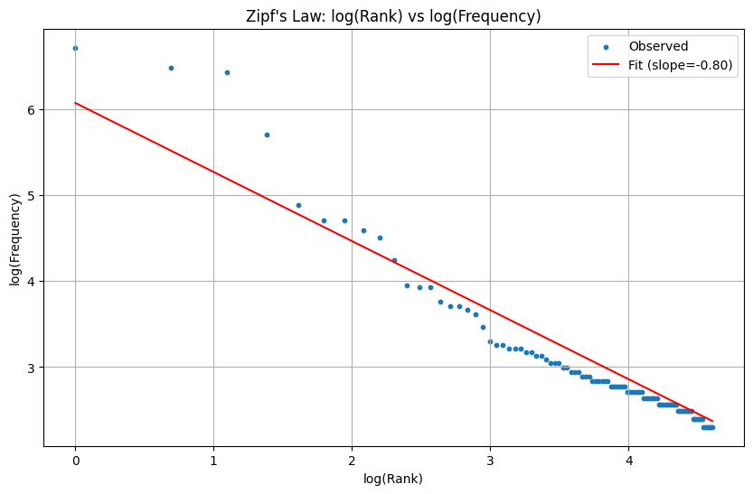
Applying Zipf’s Law
Step 1: Rank and Frequency Calculation
Counted occurrences of each word in the dataset.
Assigned a rank based on descending frequency (Rank 1 = most frequent word).
Step 2: Log-Log Transformation
Transformed both word rank and frequency to logarithmic scale using NumPy.
Zipf’s Law predicts:
log(frequency) ≈ -s ⋅ log(rank) + C
where s ≈ 1 and C is a constant.
Step 3: Plotting & Line Fitting
Plotted log(rank) vs. log(frequency).
Fitted a linear regression line to the log-log plot.
The slope of the line closely approached -1, validating
Zipf’s Law.
Step 4: Interpretation
The linearity of the log-log graph confirms a power-law distribution.
Demonstrates that natural language in the dataset follows Zipf’s distribution.

Slide 8
Result and Observation
Zipf’s Law Validated
The log-log plot of word rank vs. frequency displayed a near-linear trend.
The calculated slope was approximately -1, aligning well with Zipf’s Law expectations.
Key Observations
A few words occurred very frequently, such as common connectors or sentiment words.
Most words appeared only once or twice, forming a long tail — typical in natural language.
Statistical Insight
Demonstrated that word usage in global sentiment expressions naturally follows a power-law distribution.
Confirms that Zipf’s Law is language-independent and holds across informal, social media-style texts.
Broader Implication
Highlights the efficiency and redundancy of human language.
Useful in NLP applications such as compression, search optimization, and keyword extraction.

Slide 9
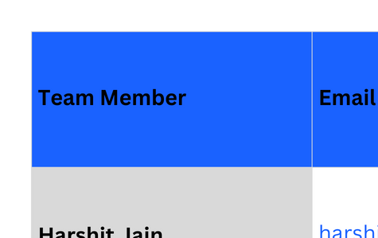
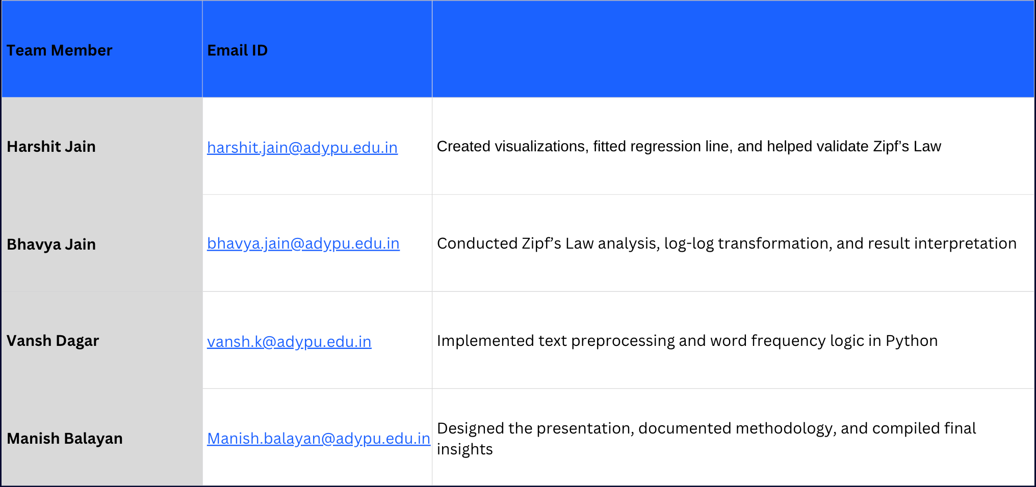
Individual Contributions

Slide 10
Thank You

